Slide 1
Image Formation Fundamentals
Structure of Human Eye and
Image formation

Slide 2
Human Visual system
The human visual system consist of the two primary components-the eye and the brain, connected to the optic nerve
Eye- receiving sensor (camera, scanner)
Brain – information processing unit (computer system)
Optic nerve – connection (physical component)

Slide 3
Human visual system
The function of the human visual system is to detect electromagnetic radiation (EMR) emitted by the objects
Humans can detect light wavelength between 400-750nm.
Perceived color is related to wavelength of light
Brightness is related to the intensity of the radiation

Slide 4
Function of human visual system
Discrimination of objects
Movement detection
Color detection

Slide 5
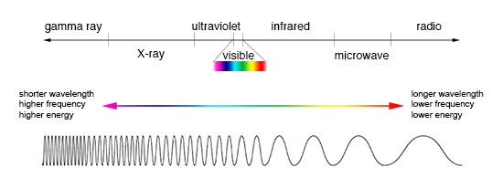
Electromagnetic spectrum

Slide 6
Visible Spectrum
Visible spectrum can be divided into 3 bands
Red : 400-500nm
Green: 500-600nm
Blue: 600-700nm
Sensors to sense these bands are located in the eye

Slide 7
Structure of Human Eye
Eye is nearly spherical in shape with average diameter of 20mm
Three membranes enclose the eye
Cornea
Choroid
Retina
Receptors: Cones and Rods responsible for vision

Slide 8
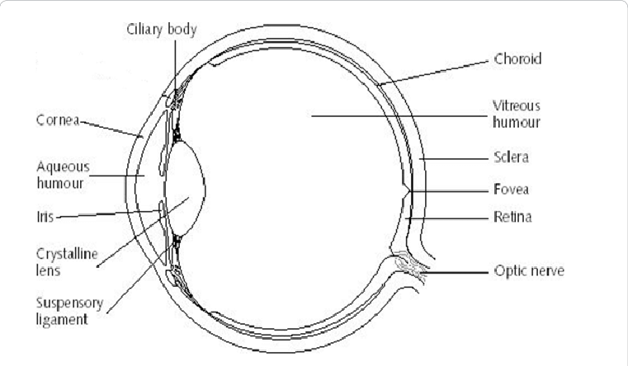
Structure of Human Eye

Slide 9
Human eye and image formation

Slide 10
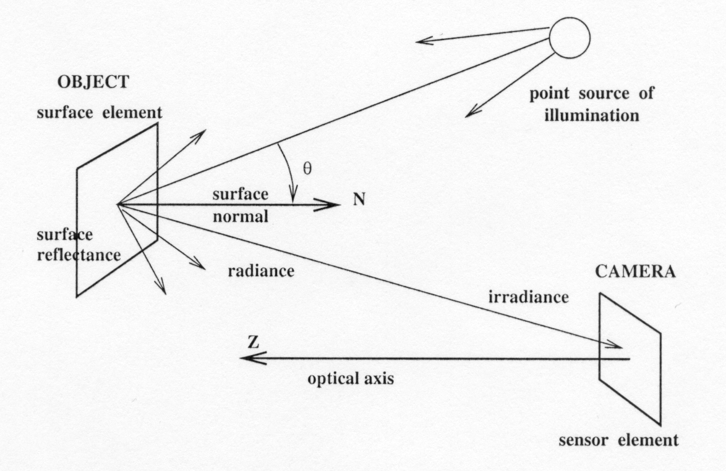
A Simple model of image formation
The scene is illuminated by a single source.
The scene reflects radiation towards the camera.
The camera senses it via chemicals on film.
courstey UNR computer vision course

Slide 11
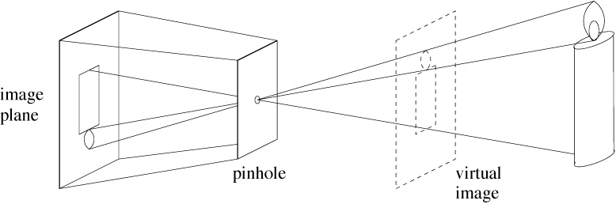
Pinhole cameras
Abstract camera model - box with a small hole in it
Pinhole cameras work in practice
courstey Dr. G. D. Hager

Slide 12
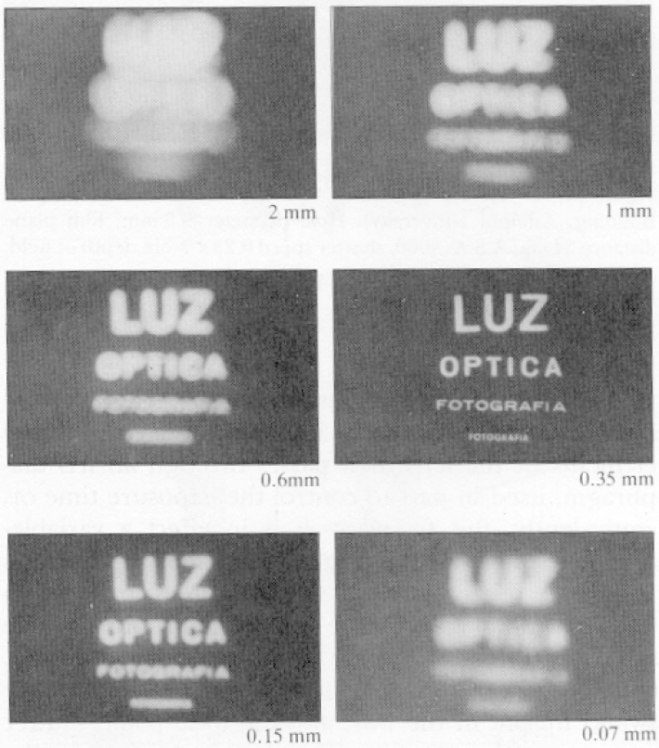
Real Pinhole Cameras
Pinhole too big -
many directions are
averaged, blurring the
image
Pinhole too small-
diffraction effects blur
the image
Generally, pinhole
cameras are dark, because
a very small set of rays
from a particular point
hits the screen.
courstey Dr. G. D. Hager

Slide 13
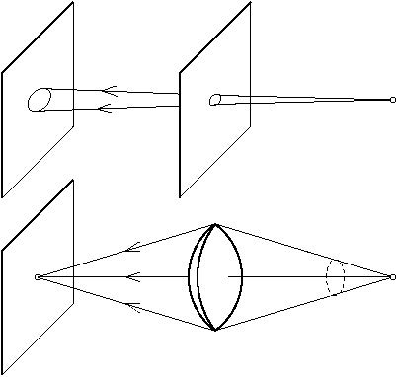
The reason for lenses
Lenses gather and focus light, allowing for brighter images.
courstey Dr. G. D. Hager

Slide 14
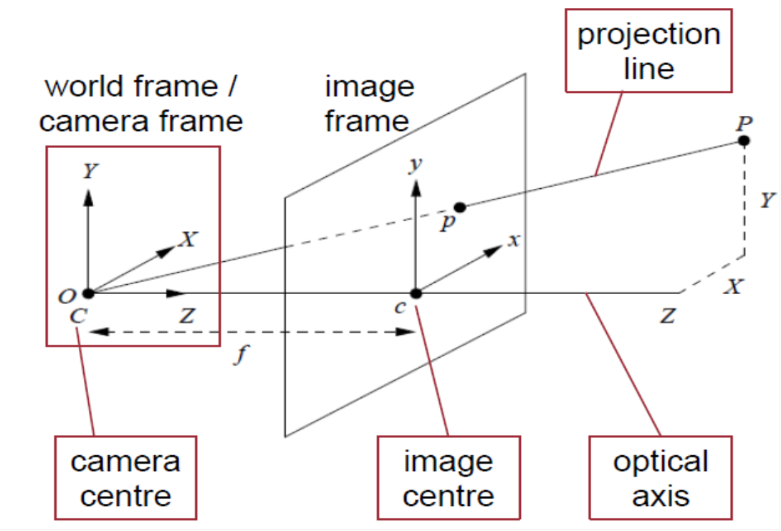
Equation of Projection

Slide 15
Equation of Projection

Slide 16
Image Sensing & Acquisition

Slide 17
Introduction
Nothing happens in a machine vision application without the successful capture of a very high quality image
– Image quality: correct resolution for the target application with best possible feature contrast
Resolution – determined by sensor size and quality of optics
Feature contrast – determined by correct lighting technique and quality of optics
– Imaging is said to contribute more than 85% to the success of any machine vision application
– The goal of machine vision image acquisition is to create an image that is usable by the technology – not necessarily one that’s pleasing to the human eye

Slide 18
Sensors and Imaging
All machine vision cameras create an image by exposing arrays of photosensitive material to light energy
Think of photon “buckets”
Exposure duration is time limited and typically adjustable
The energy in a “bucket” captured during an exposure period becomes a micro‐voltage for that “bucket”

Slide 19
Sensors and Imaging
Each element in a camera sensor array is called a pixel (picture element)
The energy value for each individual pixel is output as a micro‐voltage upon acquisition of each image
The voltage ultimately determines the color level for that pixel
The pixel and data transfer architecture varies by sensor type
Most widely used are CCD and CMOS

Slide 20
Sensing and Imaging

Slide 21
Image Acquisition
The imaging sensor array comes in different physical layouts
Area
Line
Size of the chip varies widely as does the number of individual picture elements (pixels)
Typical area chip for machine vision: from .3 to 5+ Mpix
640 to 2048+ pixels (horizontal)
Physical sizes from ¼” diag. up to 1”+
Typical line scan array: from 1K to 12K+ pixels
Physical sizes from about 15mm to 90mm+

Slide 22
Image Acquisition
Image representation in the computer

Slide 23
Requirements for image acquisition
Optic:
Lenses should have light gathering capability and resolution
Specialty lenses: Telecentric, microscopic, zoom

Slide 24
Requirements for image acquisition
2. Lighting: Correct lighting must
Highlight features to be detected elative to the background
Create repeatable images regardless of part variation
Vision cameras and software algorithms CANNOT makeup for inadequate illumination techniques

Slide 25
Spatial and Intensity Resolution

Slide 26
Spatial Resolution
It is the smallest detail in an image
It can be stated in number of ways:
Line pairs per unit distance
Pixels per unit distance
OR
DPI (Dots Per Inch) refers to printer esolution, or, the number of dots of ink on a printed image
PPI- Pixels per inch

Slide 27
Spatial Resolution
Image resolution is typically described in PPI, which refers to how many pixels are displayed per inch of an image.
Higher resolutions mean that there more pixels per inch (PPI), resulting in more pixel information and creating a high-quality, crisp image.
Images with lower resolutions have fewer pixels, and if those few pixels are too large (usually when an image is stretched), they can become visible like the image below.
When you change the resolution of an image, you are saying how many pixels you want to live in each inch of the image.
For example, an image that has a resolution of 600 ppi will contain 600 pixels within each in of the image.
When scanning or photographing, always try and capture the image at the largest resolution/quality. WHY?

Slide 28
Intensity Resolution
It is the smallest change in the intensity level of the image

